Slide 1

SNOWPRO ADVANCED: DATA ENGINEER (DEA-C02)
Section 2.1: Troubleshoot
Underperforming Queries
An end-to-end certification masterclass covering performance diagnosis, telemetry evaluation, root cause identification, and query execution optimization.

Slide 2
DOMAIN 2.0 • WEIGHTAGE: 19%
Performance Optimization Framework
Domain 2 evaluates your ability to maintain SLA compliance, scale compute efficiently, and resolve database bottlenecks across enterprise cloud workloads.

Slide 3

Section 2.1 Exam Objectives Overview
1. Identification & Telemetry
2. Root Cause & Remediation
Identify Underperforming Queries: Isolate queries violating SLAs using Snowsight Query History, `ACCOUNT_USAGE` views, and Information Schema.
Identify Root Cause: Differentiate between warehouse queueing, spilling (Local vs. Remote), unpruned scans, and Cartesian join fan-out.
Outline Telemetry: Analyze Query Profile operator DAGs, memory spillover, micro-partition pruning ratios, and execution metrics.
Increase Efficiency: Apply targeted fixes including re-clustering, Search Optimization, query rewrite, and Scale-Up vs. Scale-Out tuning.

Slide 4
PILLAR 1
Identify Underperforming Queries
Discovering long-running, queued, or resource-heavy workloads using Snowflake system tools and system views.

Slide 5



Primary Query Monitoring Instruments
Snowsight UI
Information Schema
Account Usage Schema
Real-time visual monitoring for immediate interactive troubleshooting. Provides interactive Query Profile graphical DAG and execution history for up to 14 days.
Real-time programmatic table functions (e.g., QUERY_HISTORY()). Zero latency for active troubleshooting with history retained for 7 days.
Historical telemetry repository in SNOWFLAKE.ACCOUNT_USAGE. Holds 365 days of data with up to 45 minutes of latency for enterprise auditing.

Slide 6
Monitoring Tools Comparison Matrix
Feature / Dimension | Snowsight UI | Information Schema | Account Usage Views
Data Retention | 14 Days | 7 Days | 365 Days (1 Year)
Latency | Real-time | Real-time (0 latency) | 45 Minutes Latency
Dropped Object History | Current objects | Current objects only | Includes Dropped Objects
Primary Usage | Visual DAG inspection | Session & real-time scripts | Account-wide trend analysis

Slide 7
Key Performance Indicators (KPIs)
Critical Performance Thresholds
>0
Elapsed Execution Time: Benchmark queries exceeding normal baseline operational SLAs.
Compilation Ratio: High compilation time (>50% of total elapsed time) flags complex expressions or giant IN-clauses.
Bytes Spilled To Remote
Queue Time: Any non-zero value in QUEUED_OVERLOAD_TIME signals warehouse concurrency saturation requiring capacity adjustments.

Slide 8
Spotting Query Anomaly Symptoms
Excessive Execution Time: Queries running longer than operational baselines due to unpruned scans or spilling.
High Queue Overload Time: Indicates warehouse resource congestion; queries wait for compute threads to become free.
High Compilation Time: Caused by complex query generators, massive lists of literal values, or hundreds of nested views.
Disk Spilling Alerts: Memory exhaustion forces local SSD overflow or remote cloud storage spilling.

Slide 9
PILLAR 2
Outline Telemetry Around Operations
Deep-dive into the Snowflake Query Profile DAG, execution statistics, and execution plan operators.

Slide 10
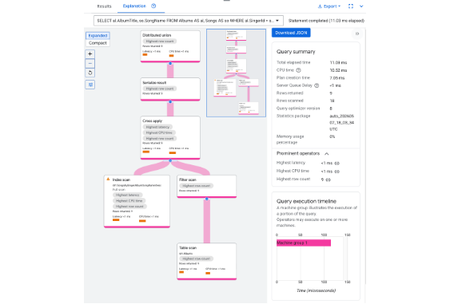
Snowflake Query Profile Architecture
Understanding the Profile DAG
The Query Profile renders execution as a Directed Acyclic Graph (DAG) of physical operators.
Major Category Breakdown:
•
Processing: CPU execution time for computing results.
•
Local I/O: Reading/writing data to local warehouse SSDs.
•
Remote I/O: Reading from cloud storage (S3/GCS/Azure Blob).
•
Network: Inter-node data shuffling during joins.

Slide 11
Key Profile Relational Operators
Data Access & Filtering
Data Processing & Joining
TableScan: Reads micro-partitions from storage. Inspect the ratio of Partitions Scanned vs. Total Partitions.
Join / JoinFilter: Combines data streams. Watch for row explosion where output rows heavily exceed input rows.
Filter: Applies predicate conditions. If placed above a TableScan without reducing scanned partitions, pruning failed.
Aggregate / Sort: Groups or orders data. High memory consumers that trigger disk spilling if batch sizes are huge.

Slide 12



Essential Telemetry Metrics to Master
Partition Pruning Ratios
Disk Spilling Volumes
Network Transmission
Compares partitions_scanned against partitions_total. Efficient queries scan <10% of total partitions.
Tracks BYTES_SPILLED_TO_LOCAL_STORAGE and BYTES_SPILLED_TO_REMOTE_STORAGE when RAM is exceeded.
Measures inter-node data shuffling during distributed joins or heavy aggregations across warehouse nodes.

Slide 13
Pre-Execution Telemetry with EXPLAIN
SYSTEM$EXPLAIN_PLAN_JSON()
EXPLAIN SQL Command
Returns the logical execution plan as a JSON formatted string without executing the query or consuming warehouse compute credits.
Evaluates query structure, predicate evaluation order, and potential join strategies prior to deployment.
Exam Distinction: EXPLAIN shows estimated execution paths; Query Profile shows actual runtime metrics and telemetry.
Allows pre-execution inspection of predicted operator trees and estimated cost structures.

Slide 14
PILLAR 3
Identify the Root Cause
Correlating telemetry symptoms to underlying architectural and SQL anti-patterns.

Slide 15
Root Cause Diagnostic Matrix
Telemetry Symptom | Underlying Root Cause | Impact Level
QUEUED_OVERLOAD_TIME > 0 | Warehouse concurrency capacity reached; too many concurrent queries. | High (Delayed Start)
Bytes Spilled to Local Storage | Warehouse node memory (RAM) exhausted; written to local SSD. | Moderate Degradation
Bytes Spilled to Remote Storage | Local SSD exhausted; written to cloud object storage (S3/GCS/Azure). | Severe Degradation
Partitions Scanned ≈ Total | Poor pruning caused by missing cluster key or functions in WHERE clause. | High (Excess I/O)

Slide 16
Disk Spilling Mechanics Explained
1. Local SSD Spilling
2. Remote Cloud Spilling
Occurs when memory required for join states or sorting operations exceeds worker node physical RAM.
Occurs when both worker node RAM and local SSD storage are completely exhausted.
Data is written to fast local NVMe SSDs. Causes moderate query slowdown but avoids query failure.
Data spills to remote cloud storage. Incurs massive network I/O latency penalty. Primary fix: Scale UP warehouse.

Slide 17
Why Micro-Partition Pruning Fails
Non-SARGable Predicates
Unclustered & High-Cardinality Data
Applying functions directly to filtered columns breaks metadata pruning.
Data inserted randomly without natural alignment spreads matching values across all micro-partitions.
Anti-Pattern: WHERE YEAR(order_date) = 2026 forces full table scan because min/max metadata cannot be evaluated against expressions.
Without explicit Clustering Keys, Snowflake cannot bypass irrelevant micro-partitions.

Slide 18
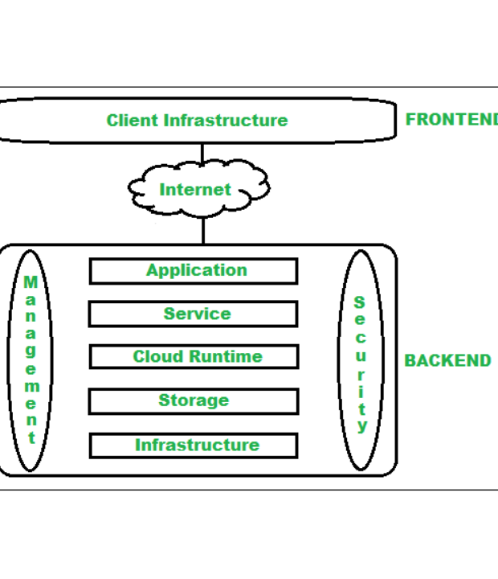
Join Fan-Out & Row Explosion
Row Explosion Mechanics
Row explosion occurs when a join operator produces output row counts orders of magnitude higher than input records.
Primary Causes: Non-unique join keys, missing join predicates causing Cartesian cross-joins, or many-to-many join duplication.
This consumes massive memory, leading directly to remote disk spilling.

Slide 19
PILLAR 4
Increase Query Efficiency
Architectural optimizations, SQL refactoring, and virtual warehouse resizing strategies.

Slide 20



Storage & Layout Optimizations
Clustering Keys
Search Optimization
Materialized Views
Explicitly order micro-partitions for large multi-terabyte tables based on frequent filter/join columns to optimize pruning.
Maintains persistent search access paths for fast point-lookup queries on high-cardinality columns (e.g., UUID lookup).
Pre-computes and maintains aggregated or filtered query patterns automatically without manual ETL pipelines.

Slide 21
SQL Rewriting & Predicate Best Practices
Use SARGable Date Ranges: Replace WHERE DATE(created_at) = '2026-01-01' with range filters WHERE created_at >= '2026-01-01' AND created_at < '2026-01-02'.
Avoid SELECT *: Project only explicitly required columns to reduce scanned I/O and worker memory consumption.
Pre-Aggregate Joins: Group data before joining to prevent intermediate join fan-out and memory spilling.
Optimize CTEs & Subqueries: Ensure CTEs do not materialise unnecessary result sets before downstream filters apply.

Slide 22
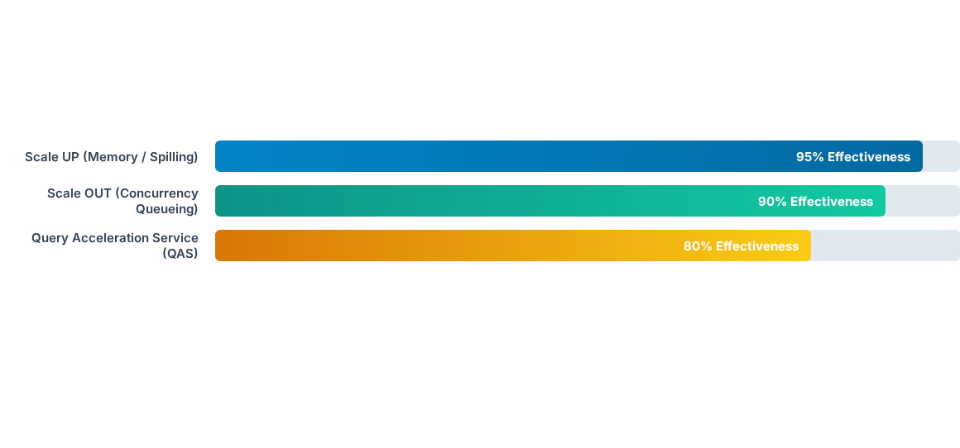
Warehouse Tuning Decision Comparison
Choose Scale UP for memory-bound heavy single queries; choose Scale OUT (Multi-Cluster) for queue time caused by concurrent queries.

Slide 23
Scale UP vs. Scale OUT Decision Matrix
Problem Indicator | Action Required | Mechanism / Property
Disk Spilling (Local/Remote) | Scale UP | Increase Warehouse Size (e.g., Medium → Large doubles RAM per node).
Queueing Overload Time | Scale OUT | Enable Multi-Cluster Warehouse (increase MAX_CLUSTERS).
Ad-hoc Large Table Scans | Query Acceleration (QAS) | Enable QUERY_ACCELERATION_MAX_SCALE_FACTOR.
Heavy Python / Snowpark Workloads | Snowpark-Optimized | Switch to Snowpark-Optimized Warehouse (16x memory per node).

Slide 24
DEA-C02 Exam Quick Reference Cheat Sheet
Spilling to Local Storage: Minor memory issue. First check query optimization, then consider Scaling UP.
Spilling to Remote Storage: Major bottleneck. Primary resolution is Scaling UP warehouse size.
High QUEUED_OVERLOAD_TIME: Solve by adjusting Multi-Cluster scaling policy or increasing Max Clusters.
Point Lookups on Billions of Rows: Enable Search Optimization Service (SOS).

Slide 25
Ready for DEA-C02 Success!
You have mastered Section 2.1: Troubleshoot Underperforming Queries.
SnowPro Advanced: Data Engineer Certification Masterclass

Slide 26


Image Sources
https://docs.cloud.google.com/static/spanner/docs/images/co-located-query-plan.png
Source: docs.cloud.google.com
https://media.geeksforgeeks.org/wp-content/uploads/20210318074917/archcloud2.png
Source: www.geeksforgeeks.org

